Slide 1



What Hand Writing
was against us
in Colossians 2?
Notes:
Col 2: Handwriting of Ordinances, 1 hr: Website: https://studythecalendar.com/are-you-confused-about-colossians-2/ Youtube:

Slide 2



a teaching
From:
Addressing Yahuah’s Feasts in Colossians 2

Slide 3

Just for Clarification:
In my presentations, I am using YHVH (Yahuwah) instead of LORD, which is a title and not a name. I also use Yahusha instead of Jesus, which is not a translation but a transliteration which really has no meaning, neither in Hebrew nor in English!
YHVH (Yahuwah) and Yahusha are the actual original names and represent the
true nature and character of our Creator.

Slide 4
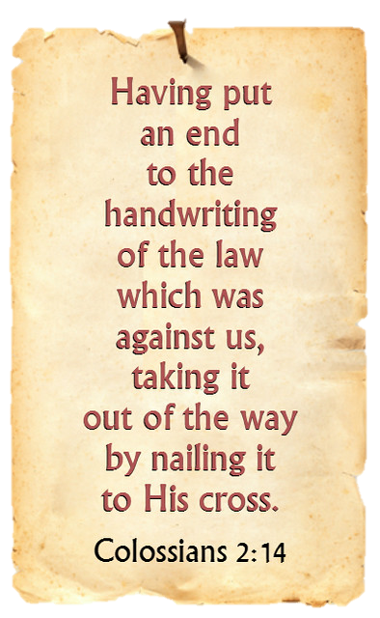

4

Slide 5

Scripture says:
”Prove all things; hold fast that
which is good.”
1 Thessalonians 5:21

Slide 6





What about Colossians 2:14-17?

Slide 7
Are the yearly feast days still binding for Christians today?

Slide 8
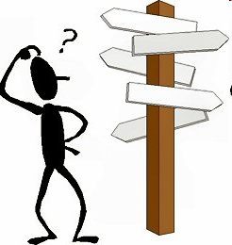
Does the Creator allow Man to choose his own religious festivals according to his discretion?

Slide 9

Doesn’t Colossians 2:14-17 clearly state that YHVH’s yearly appointed times (feast days) were abolished at the cross?
9

Slide 10
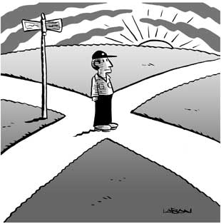
Let’s look at Colossians Chapter 2 a little closer!
This presentation is dedicated to the second chapter of Colossians, verses 14-17.
We will also investigate various Bible translations.

Slide 11
Why? Because honesty requires that we examine several translations
of this text.
First the question:
Could Colossians be
one of the letters Peter
is talking about in 2 Peter 3:15-17, where it says:

Slide 12
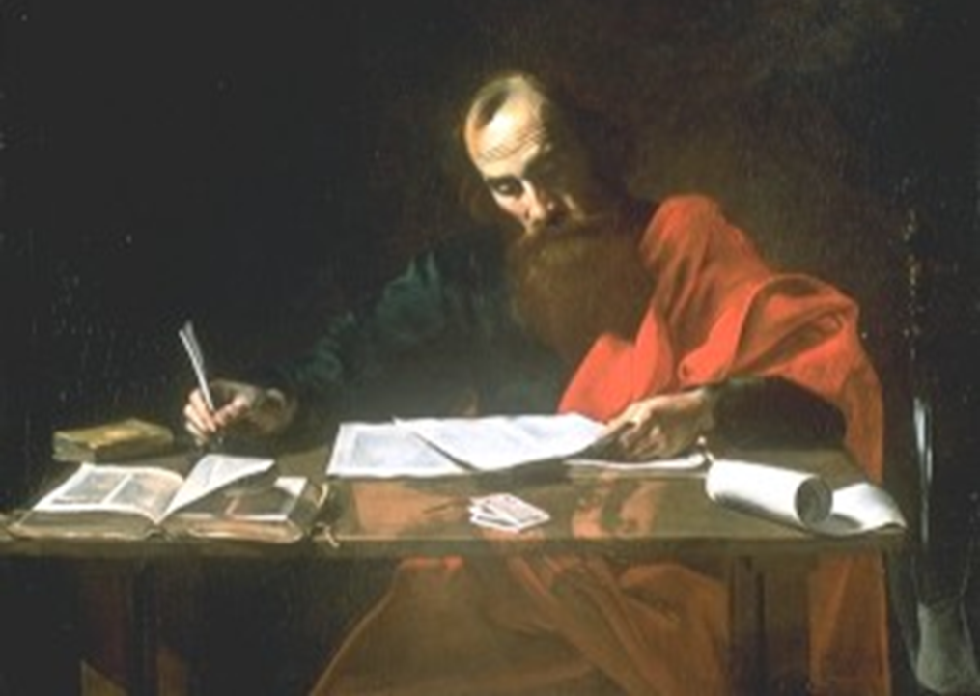

“And account that the longsuffering of our Master is salvation; even as our beloved brother Paul also according to the wisdom given unto him hath written unto you; 16 As also in all his epistles, speaking in them of these things; which they that are unlearned and unstable wrest, as they do also the other Scriptures, unto their own destruction.”

Slide 13
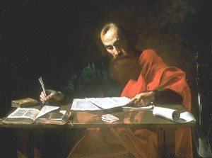
Paul was a Scholar!
Peter was a simple fisherman!
We can understand Peter’s concern.
Some things that Paul wrote are very difficult
to understand.
Paul was a Pharisee;
he knew and understood the Hebrew Scriptures back and forth.

Slide 14
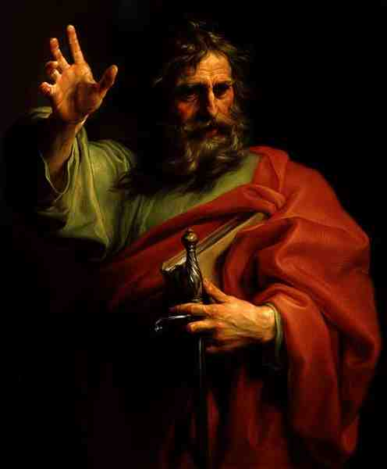
Before the Council, Paul stated in
Acts 23:6
“I am a Pharisee, the son of a Pharisee.”

Slide 15
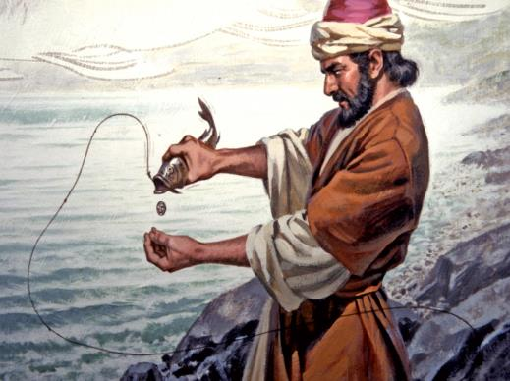
Peter was a simple fisherman on the other hand.
And like most people today that are not so familiar with the Scriptures,
Peter was no Scholar of the Old Testament Scriptures. There are many things in the Bible, that are not very familiar to us and
sometimes some things
do not make sense.

Slide 16

For that reason, we must read Paul’s writings very carefully and not take them out of context and twist them to our own destruction.
How can we make sure that we do not twist Paul’s writings?

Slide 17
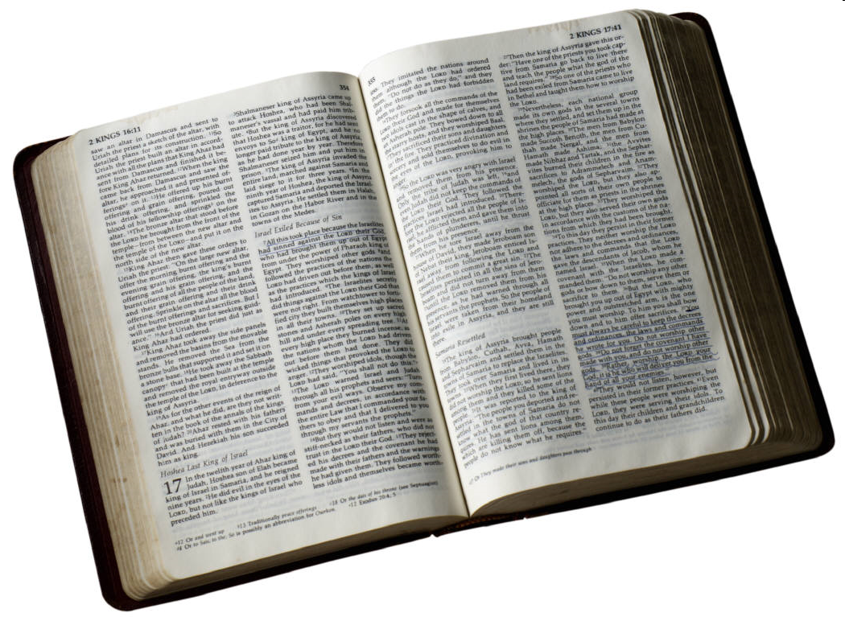
We must copy the assembly of Berea
(Acts 17:10-22) in that we daily search the Scriptures in order to know if the teachings of Paul agree with Scripture.
Is that a good idea?

Slide 18
What Scripture did they research?
Was it the New Testament?
No, because that was not written yet.

Slide 19
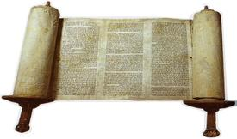
They compared
everything with the
so-called Old Testament,
the Hebrew Scriptures,
the Torah, the Prophets
and the Psalms.
If the teachings of Paul would have not agreed with those, they would have rejected his messages.

Slide 20
Should we do the same today?
Absolutely! It is even more important today to prove everything. The Bible does not contradict itself, for that reason we must check out Paul’s writings and every other preacher, including Ellen G White for SDA’s.
We must compare them with the Torah.
That is our personal responsibility
and our duty.

Slide 21
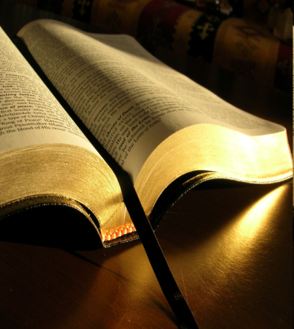
Yahusha gives the same warning!
He states in Matthew 24:4,
“Take heed,
that no man deceive you.”

Slide 22
Someone is out to deceive us:
Peter stated clearly in 1 Peter 5:8
exactly who this “someone” is:
“Be sober, be vigilant; because
your adversary the devil,
as a roaring lion, walketh about, seeking whom he may devour.”

Slide 23
2 Corinthians 11:14
“Satan himself is transformed
into an angel of light.”
That is why we are commanded in 1 Thessalonians 5: 21 to “Prove all things,
hold fast that which is good!”

Slide 24

In 1 John 4:1 we are told
to try the spirits.
“Beloved, believe not every spirit, but try the spirits whether they are of God (Elohim); because many
false prophets are gone out into the world.”
Notes:
This is a command!

Slide 25
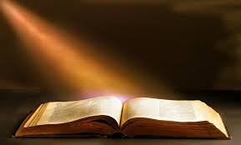
Let’s remember, Scripture is the test of all doctrines,
only by it, beginning in Genesis 1:1 we can know
what is truth and what is not!
25

Slide 26
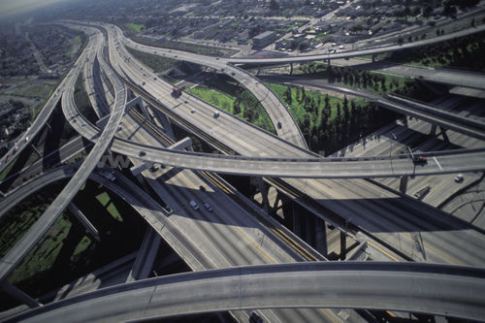
Now the question:
Are you also confused about
Colossians 2:14-17?

Slide 27

Are the yearly feast days still binding for
Christians today?
Doesn’t Colossians 2:13-17 make it clear that the feast days
ended at the cross?
Colossians is one of the letters over which most Christians fall to their own destruction, like Peter said.

Slide 28
Let us read Colossians 2, starting in verse 13 to 17 in the KJV:
13. And you, being dead in your sins, and the uncircumcision of your flesh, hath he quickened together with him, having forgiven you all trespasses; 14. Blotting out the handwriting of ordinances that was against us, which was contrary to us, and took it out of the way, nailing it to his cross.
15. And having spoiled principalities and powers, he made
a shew of them openly, triumphing over them in it.
16. Let no man therefore judge you in meat, or in drink,
or in respect of an holyday, or of the new moon [month],
or of the Sabbath days. 17. Which are a shadow of
things to come; but the body is of Messiah.”

Slide 29
What was nailed to the cross?
It depends on who you ask and which Bible translation one reads!
Many read various translations and come to various conclusions!
That is sad, but it is the truth!

Slide 30
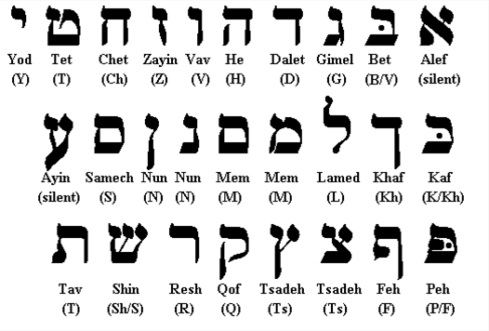
In order to find out the truth, one must go back to the original Hebrew Scriptures, because YHVH wrote only one Bible.
30

Slide 31
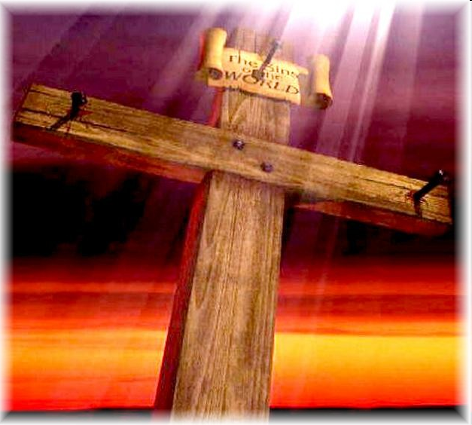
Most Christians claim that the sentence in the KJV: “Handwriting of ordinances” that “was against us,
which was contrary to us” refers to the law of Moses. Therefore, most come to the conclusion that the whole law, or part of it, ended at the cross, therefore claiming these laws are
no longer valid for Christians.
That was verse 14.
We will talk
about that later.
31

Slide 32

Here are some examples of statements from other churches
in reference to Colossians 2:16 and the following question:
“Are the 10 Commandments abolished?”
“Jesus removed the ordinances,
so, we need not keep the laws regarding foods, holy days, or the Sabbath (Col. 2:16). But the Sabbath was one of the Ten Commandments, hence, all the Old Testament laws were removed, including the Ten Commandments and the Sabbath.”
- Gospelway.com – “Old Testament Laws”
32

Slide 33
Here are some examples of statements from other churches
in reference to Colossians 2:16 and the following question:
“Are the 10 Commandments abolished?”
“Jesus removed the ordinances,
so, we need not keep the laws regarding foods, holy days, or the Sabbath (Col. 2:16). But the Sabbath was one of the Ten Commandments, hence, all the Old Testament laws were removed, including the Ten Commandments and the Sabbath.”
- Gospelway.com – “Old Testament Laws”
IS THAT CORRECT?
33

Slide 34
It is important for me to insert this explanation:
If we understand that we are dealing with two different Messiahs, we know that it
is the Greek, Christian Jesus, (or the false messiah), who claims that the 10 Commandments
are no longer binding for Christianity.
However, the Hebrew Messiah by the name of Yahusha did not do away
with the Father’s Commandments and Statutes!
They are still binding for His followers.
An important explanation must be inserted here:
If we understand that we are dealing with
two different Messiahs, we know that it is the
Greek Christian Jesus, (or the false messiah),
who claims that the 10 Commandments
are no longer binding for Christianity.
However, the Hebrew Messiah by the name of Yahusha did not do away with any
Commandments and Statutes in the
blood-ratified everlasting covenant!
They are still binding for His followers
as long as time should last.
34

Slide 35
Here is another example: Question: Was the 7th Day Sabbath abolished? Bible.ca – “Sabbath Keepers Refuted”
“The Sabbath commandment was stated to be abolished
in Col 2:14-16.
This means that under the
New Covenant law, 9 of the 10 Commandments have been carried forward and
one is abolished.”
This Christian church comes to the same conclusion!
35

Slide 36
Was the 7th Day Sabbath abolished?
Bible.ca – “Sabbath Keepers refuted”
“The Sabbath commandment was stated to be abolished
in Col 2:14-16.
This means that under the
New Covenant law, 9 of the 10 commandments have been carried forward and
one is abolished.”
But are they correct?
This church comes to the same conclusion!
36

Slide 37
Now another denomination comes along, and
they have a different opinion regarding Colossians 2:16!
They state in their Bible Commentary, Volume 7,
page 205: “Sabbath days cannot refer to the weekly Sabbath, designated by the fourth commandment,
but must indicate the ceremonial rest days.”
Is that correct? Are they right?
37

Slide 38

Remember also, that YHVH
is not the author of confusion; someone else is!
The correct answer can be found only in Scripture!

Slide 39
When we read Paul‘s letters,
we should remember, that he was
a student of the Old Testament Scriptures.
Paul was a rabbi, a scribe who knew the Old Testament in and out.

Slide 40
Paul was a Jew of Jews,
a Pharisee of the Pharisees.
Paul was a student of the
Old Testament Scriptures.
The OT was his primary point of reference for religious studies and teaching.
The New Testament was not written yet.

Slide 41

My question is: “Where did Paul get this terminology holyday or of the new moon [month],
or of the Sabbath [days] from?”
There are several places in the Scriptures where we find this terminology.
The following passages will explain exactly where Paul learned this terminology.
Note: the term “new moon” has been incorrectly translated. “New month” is the correct term.

Slide 42
Here is the sequence:
(Note: words in parenthesis are added.)
Feasts or feast days (yearly)
New Moons [new months] (monthly)
Sabbaths (weekly)
Here are the Bible texts where Paul must have received this terminology:
42

Slide 43
#1. 2 Chronicles 2:4
"Behold, I build an house to the name of YHVH my Elohim, to dedicate [it] to him, [and] to burn before him sweet incense, and for the continual showbread, and for the burnt offerings morning and evening, on the Sabbaths (weekly),
and on the new moons [new months] (monthly),
and on the solemn feasts (annually) of YHVH our Elohim. This is an ordinance for ever to Israel.”
43

Slide 44
#2. 2 Chronicles 8:13
“Even after a certain rate every day, offering according to the commandment
of Moses, on the Sabbaths (weekly),
and on the new moons [new months] (monthly),
and on the solemn feasts (annually),
three times in the year, [even] in the feast of unleavened bread, and in the feast of weeks, and in the feast of tabernacles.”
44

Slide 45
#3. 2 Chronicles 31:3
“[He appointed] also the king's portion of his substance for the burnt offerings, [to wit],
for the morning and evening burnt offerings, and the burnt offerings for
the Sabbaths (weekly), and for
the new moons [new months] (monthly), and for
the set feasts (annually), as [it is] written
in the law of YHVH.”
45

Slide 46
#4. Nehemiah 10:33
“For the showbread, and for the
continual meat offering, and for the continual burnt offering,
of the Sabbaths, (weekly)
of the new moons [new months], (monthly)
for the set feasts, (yearly) and for the holy [things], and for the sin offerings to make an atonement for Israel, and [for] all the work of the house of our God (Elohim).”
46

Slide 47
#5. Ezekiel 45:17
“And it shall be the prince's part [to give] burnt offerings, and meat offerings, and drink offerings,
in the feasts (annually), and
in the new moons [new months] (monthly), and
in the Sabbaths (weekly),
in all solemnities of the house of Israel:
he shall prepare the sin offering, and the meat offering, and the burnt offering, and the peace offerings,
to make reconciliation for the house of Israel.”
47

Slide 48

These weekly, monthly and annually
set-apart times are HIS appointments.
These are NOT Jewish or man-made dates!
The Creator invites us; we do not invite HIM.
48

Slide 49

What must be the logical conclusion when looking at these Old Testament verses we just saw?
The same principle must be applied to Colossians 2:16, because Colossians 2:16 speaks about the yearly, monthly and weekly appointments - not the yearly, monthly and
yearly appointments.
49

Slide 50
Did Paul needlessly repeat himself?
Did he know what he was saying?
Or did he have this in mind?
“Let no man therefore judge you in meat, or in drink, or in respect of a yearly ceremonial Sabbath, or of the new month, or of the yearly ceremonial Sabbaths” …?? (Colossians 2:16, NRPV)
We need to ask the question, “What version is the NRPV?”
NRPV = Needlessly Repetitive Paul’s Version
50

Slide 51

Don’t laugh! This is not funny, because this it is exactly
what many denominations believe and teach their people (including Sabbath-keeping churches).
However, some Scholars don’t go along with that teaching, because they do agree
that the 7th day Sabbath is
the intent of Paul’s statement.
51

Slide 52
Here is the proof:
“… When Paul here refers to ‘Sabbaths’, if he meant the ceremonial (annual) Sabbaths,
he was needlessly
repeating himself.”
Ministry Magazine, May 1997;
Dr. Richardson, Andrews University.
52

Slide 53
Let’s read Colossians 2:16 again:
“Let no man therefore judge you in meat, or in drink,
or in respect of an
Holiday (yearly) or
New Moon/New Month (monthly) or
Sabbath days (weekly).”
We see here the same sequence as yearly, monthly
and weekly as in all the other previous examples.
53

Slide 54
Therefore, the word Sabbath in Colossians 2:16 refers solely to
the weekly Sabbath and not to
any yearly Sabbath as some theologians are teaching.
Is that correct or not?
54

Slide 55
In this verse Paul is talking about:
Annual times of worship
Monthly times of worship
Weekly times of worship
55

Slide 56

All three types of holy days
stand or fall together.
We can not pick and choose!
56

Slide 57
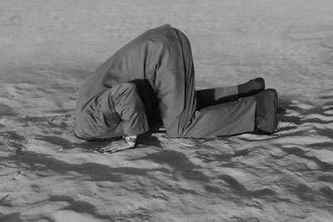
People that attempt to do away with the feast days,
(or the appointed times), by their misuse of Colossians 2:16
may be sincere, but unfortunately, they are also absolutely ignorant of the true meaning of this passage!
57

Slide 58
Again, the words “Sabbath days” in Colossians 2:16 refers without question to
only the 7th day Sabbath!
58

Slide 59

The phrase
“Sabbath days”
is found in the New Testament (KJV)
nine (9) times.
Every single time
it refers to the weekly Sabbath including
Colossians 2:16.
59

Slide 60
Sabbath “Days”
Holy days, New Months, or of the Sabbath “days” …
By the way, the word “days”
was not in the original text.
It simply reads:
“Holy days, or of the New Months,
or of the Sabbath.”
60

Slide 61
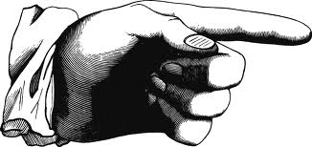
Let’s examine the first
eight (8) Bible texts.
#1 Matthew 12:5
"Or have ye not read in the Torah, how that on the Sabbath days the priests in the temple profane the Sabbath, and are blameless?”
Note: “Sabbath days” is G4521 “Sabbaton” which is the same as H7676 – a day of weekly repose.
61

Slide 62
#2 Matthew 12:10
#3 Matthew 12:12
Matt 12:10 "And, behold, there was a man which had [his] hand withered. And they asked him, saying, Is it lawful to heal on the Sabbath days
(G4521)? that they might accuse him."
Matt 12:12 "How much then is a man better than
a sheep? Wherefore it is lawful to do well on the Sabbath days (G4521)."
62

Slide 63
#4 Mark 3:4
#5 Luke 4:31
Mark 3:4 "And he saith unto them, Is it lawful to do good on the Sabbath days (G4521), or to do evil?
To save life, or to kill? But they held their peace."
Luke 4:31 "And came down to Capernaum,
a city of Galilee, and taught them
on the Sabbath days (G4521)."
63

Slide 64
#6 Luke 6:2
#7 Luke 6:9
Luke 6:2 "And certain of the Pharisees said unto them, Why do ye that which is not lawful to do
on the Sabbath days (G4521)?"
Luke 6:9 “Then said Yahusha unto them,
I will ask you one thing; Is it lawful on the
Sabbath days (G4521) to do good, or to do evil …?”
64

Slide 65

#8 Acts 17:2
"And Paul, as his manner was, went in unto them,
and three Sabbath days (G4521) reasoned with them
out of the Scriptures.”
Now we go to #9: Colossians 2:16 ~
"Let no man therefore judge you in meat, or in drink,
or in respect of an holyday (yearly), or of the new month (monthly), or of the Sabbath (G4521 - weekly) [days]:"
65

Slide 66
Now the question remains …
Why do people, including Sabbath-keeping churches, use a different rule for Col 2:16 then in all of the foregoing Bible verses?
Why not be consistent?
The only reason seems to be, that they are trying to prove with this one text that the yearly feasts of YHVH (including the New Moons [months]) have been nailed to the cross and are no longer binding.

Slide 67
In order to be consistent
with the rest of the
New Testament,
Col 2:16 refers to only
the weekly Sabbath,
never to the yearly Sabbaths!
Any other interpretation
is contrary to the uniform usage of the word Sabbath
in the New Testament.
Textually and contextually, “Sabbath Days”
in Col 2:16
refers to only
the Weekly
Seventh-day Sabbath.

Slide 68

In the New Testament, there is basically no debate among many theologians that the weekly “Sabbath days” is found many times and understood exactly as the weekly Shabbat.
Why do some theologians insist Colossians 2:16
cannot refer to the weekly Sabbath?
In fact, the majority of Bible Commentaries known to man come to the same conclusion
that the Greek word Sabbaton
in Col 2:16 also refers to the weekly Sabbath – EXCEPT …
68

Slide 69
It seems unbelievable, but it is still true!
see slide 60 – where days is added, walter says so this is a review here that is much needed.
… EXCEPT – the SDA Bible Commentary!
This commentary states these
“Sabbath days” positively refer
to the annual Festival Sabbaths
because of the phrase in
vs 17 referring to “shadow of things to come.”
This cannot be, as the word “holyday” refers to
the annual festivals – not the weekly “Sabbath.”
69

Slide 70
It seems unbelievable, but it is still true!
Is it possible that the added word “days” is the problem?
When this added word is removed, the context of the verse changes to: “an holyday [annual festival Sabbath],
or of the new moon month, or of the [weekly] Sabbath.”
Why would this make a difference?
Because, IF the verse talked about [annual] holydays
and [annual] Sabbaths, this is needless redundancy.
Remember the “bundles” in the Old Testament included: 1) the annual holy days;
2) the new month; 3) and the weekly Sabbath.
Colossians 2 follows the same pattern!
70

Slide 71
Is that strange?
Notice Paul’s words again:
"So, let no one
(or anyone)
judge you in food or
in drink, or regarding [Greek meros, meaning 'part,' or 'regarding any portion of'] a festival
or a new month or Sabbath, but the body of Messiah, which is
the Church.”
Colossians 2:16
Does it make sense?
Colossians 2:16-17 abolishes neither the weekly Sabbath nor the New Month nor the yearly divine appointments.
In fact, Colossians is the strongest proof of the entire Bible that the yearly festivals are still valid for Yahuwah’s people.
71

Slide 72
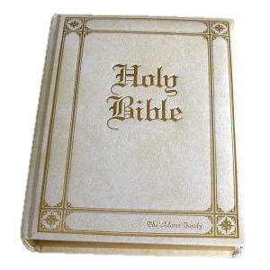
Let’s put Paul’s words in plainer English!
“Don’t let ANY ONE judge you
in food or in drink,
or regarding any part of a festival or a new month or Sabbath,
but only the Church
(the body of Messiah).”
Col 2:16
72

Slide 73
First, “anyone” means anyone, like friends, relatives, church members, priests, preachers, civil rulers, or anyone else that tries to judge us.
Secondly, the word that has been translated as “regarding” or
“in respect” of an holy day
is the Greek word “meros.”
73

Slide 74
That word “meros” comes from an obsolete but more primary form of μείρομαι - meiromai (to get as a section or allotment);
a division or share (literally or figuratively, in a wide application): - behalf, coast, course, craft, particular (+ -ly), part (+ -ly), piece, portion, respect, side, some sort (-what).
74

Slide 75
Here is a better version of this verse:
“Allow no one (no man, whoever he is) regarding any details of how you (or dictate to you how to) keep the feasts, to confuse or to judge you, but only
the assembly,
the congregation of
Yahusha can do that.
The question was not,
if they should keep the feasts, but how they should keep the feasts.

Slide 76
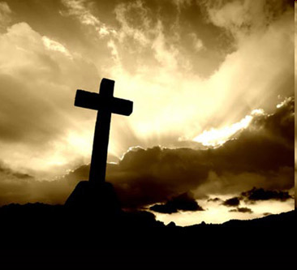
Remember, if we try to prove with Colossians 2:16 that the yearly feast days were nailed to the cross, then these verses are also definitely nailing the 7th Day Sabbath to the cross!
We all know this must be utterly false!
76

Slide 77
Colossians 2:16 does not nail
the 7th Day Sabbath, nor the
yearly appointments to the tree!
It is that simple!

Slide 78
The Colossians were converts from paganism.
How did they even know about the feast days,
the first day of the new months,
the Sabbaths or the health laws, unless Paul was teaching them these things from Scripture.
Why would he suddenly preach the opposite?
How would he preach against something,
that he himself was keeping?
(Acts 16:13; 20:1-5, 16; 1 Cor 5:6-8;
Acts 24:14 and 28:17)

Slide 79
Does it make sense?
Would Paul, who knew the
OLD Testament, preach against Moses or against the Torah?
If yes, would he have been a false prophet according to Deuteronomy 14:1-5?

Slide 80
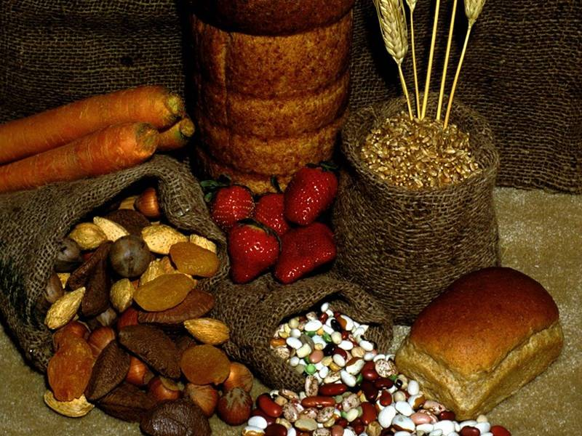
Is it possible to teach that the yearly feast days were abolished by the words:
“Let no man therefore judge you”
and at the same moment try to hold fast
to the food laws and the weekly Sabbath?
Does that make sense?
Something does not fit! Again, either all is abolished,
or nothing is. We cannot pick and choose!
80

Slide 81




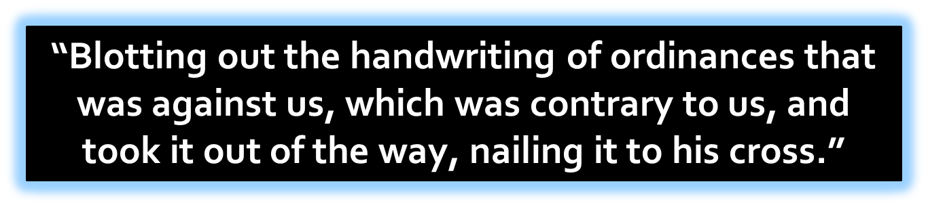
Let’s go one step further!
What was really nailed to the cross?
Let’s look at Colossians 2:14:
81

Slide 82
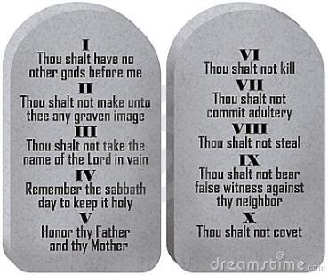
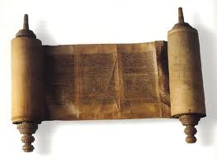
The entire Christian world seems in agreement that Col 2:14 must talk about the law that was nailed to His cross.
Some believe the Torah was abolished and some even believe the same about the 10 Commandments, or … at least that ONE of the 10 Commands is no longer valid.
82

Slide 83
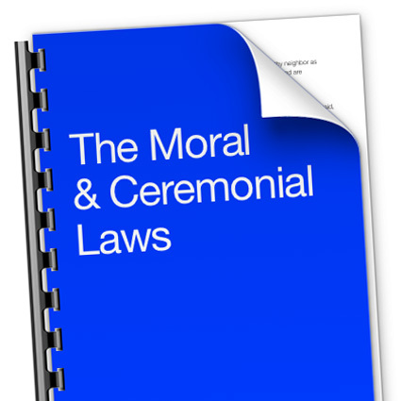
Some try to divide the law into two parts:
the Moral Law and the Ceremonial Law.
However, the words “Moral Law” or “Ceremonial Law”
do not appear in Scripture!
83

Slide 84

How do we get the idea that Colossians 2:14 is nailing the law (Torah) to the cross?
Many believe Moses wrote the law on paper, in a book, and placed it in the side of the Ark (which is true for one of the books)! Next, they assume that “book of laws” most certainly included the feasts and festivals that were connected to many “ceremonies” like the sacrificial laws.
All laws connected to ceremonies were simply abolished at the tree (cross).
84

Slide 85
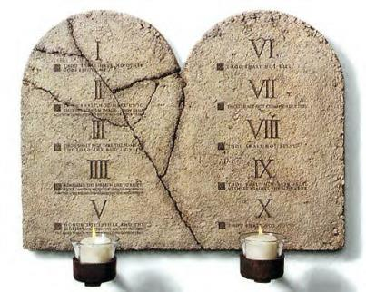
In other words:
they have some
important facts
totally mixed up!
  It is the Moral Law that was first written in the everlasting Book of the Covenant that includes the Feasts & Festivals. Yahuah then engraved those same words onto tablets of Stone – insuring they would be permanent and everlasting!
85

Slide 86
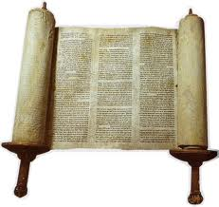
On the other hand:
  The Ceremonial Law was only written on paper and called
  The Book of the Law.
  It was only temporary!
86

Slide 87
Some Sabbath keepers claim, that since the
10 Commandments (or Moral Law written on stone), cannot be nailed to the cross,
It must be the ceremonial laws, written in a book, that are nailed to the cross.
Their reasoning is: this saves the Seventh-day Sabbath (which is part of the 10 Commandments) from being done away with.
Is that reasoning correct even though
some of the information is correct?
87

Slide 88
The problem with this theory is:
the grammar is ignored
the linguistics is ignored
the context is ignored
the Greek is ignored
the Bible is ignored
All in the favor of a theological assumption!
88

Slide 89
What are the consequences of this kind of reasoning?
These theological assumptions blind many from the reality of the linguistics and the literal meaning of this text.
Many will not be able to accept the clear letter of Scripture.
This leads many Sunday keepers to say things like: “Logic has never been a strong point with Seventh-day Adventists!” - Bible.ca
89

Slide 90
Everyone needs sound,
logical arguments!
The theological premise for this whole argument rests on the meaning
of the phrase
“handwriting of ordinances
that was against us.”
90

Slide 91
Cheirographon Tois Dogmasin
Handwriting of Ordinances in Greek is “Cheirographon Tois Dogmasin”
Cheirographon = Handwriting
Dogmasin (Dogma) = Ordinances (KJV)
Now, we just need to prove that this is referring to what some people call the Ceremonial Law.
But how do we find a Greek word in the
Old Testament that is written in Hebrew?
91

Slide 92
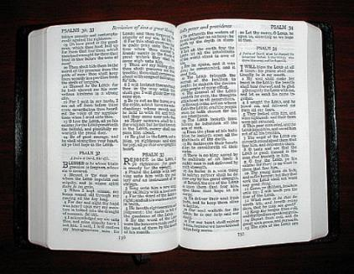
No one can biblically prove that “handwriting of ordinances” is referring to the so-called Ceremonial Law. The word “Dogmasin,” that the KJV translated as “ordinance” cannot be found in the Greek Torah.
The Greek Word for Torah (law) is “Nomos.” This word “Nomos” appears 197 times in the New Testament.
92

Slide 93

... Interestingly enough, the word “Nomos” does NOT appear even once in the book of Colossians.
That means that the word “Dogmasin” refers to NEITHER the Moral Law nor to a Ceremonial Law.
Paul wouldn’t just invent random words for the law. If he’s talking about a law found in the Torah, he would use the terms for that law as found in the Torah.
93

Slide 94
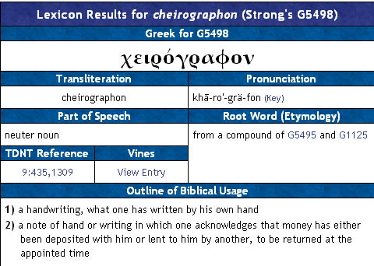
Handwriting = Cheirographon
STRONG’S LEXICON G5498
94

Slide 95
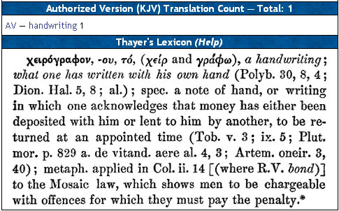
Handwriting = Cheirographon
Thayer’s Lexicon
95

Slide 96
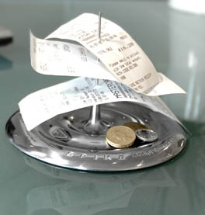
Where did this word come from?
A Receipt Spike
Originated from the practice of canceling debts by driving a spike through the certificate of debt, after which it could no longer be held against the debtor.

Slide 97
Cheirographon means anything written by hand,
but can more specifically apply to a legal document, bond, or note of debt.
What Paul is saying is, that by His death, Yahusha has justified us — brought us into alignment with His Law, His Torah, His instructions — and wiped out the note of guilt or debt that we owed as a result of our sins.

Slide 98


There are many Bible translations that have translated “Cheirographon Tois Dogmasin” correctly!
Here are some examples:
“He canceled the record of the charges against us and took it away by nailing it to the cross.” (New Living Translation)
“Elohim wiped out the charges that were against us for disobeying the Law of Moses. He took them
away and nailed them to the cross.”
(Contemporary English Version)
98

Slide 99
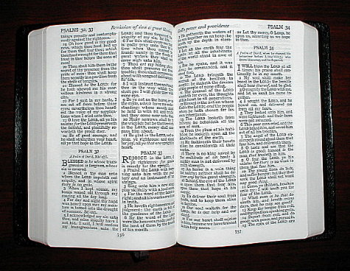
“having canceled the charge of our legal indebtedness, which stood against us and condemned us; he has taken it away,
nailing it to the cross.” (Today's NIV)
The charge of our legal indebtedness.

Slide 100
“having canceled out the certificate of debt…” (New American Standard)
A footnote on one of the Bibles said
“the record of all the sins we did.”

Slide 101
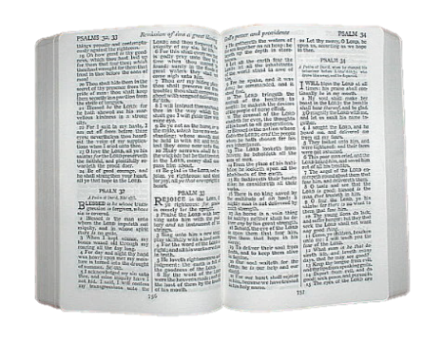
How can Paul, in this context,
be speaking about the law (Torah)
or any part of the Torah as being done away with?
We are not forgiven by
doing away with the Torah or any part of it.
The abolishing of the Torah
doesn’t make us sinless.
We need to think about this clearly!

Slide 102
To confirm any interpretation of Scripture,
it is always best to see if the rest of the Bible confirms or contrasts with the interpretation.
What does the rest of the Bible say
Yahusha came to do,
and about His relationship to the law?
From the lips of John the Baptist in John 1:29,
“Behold the Lamb of Elohim who
taketh away the sin of the world.”
(Notice He does NOT “take away” the Law or Torah!)

Slide 103
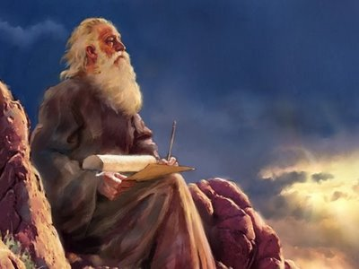
Isaiah 53:10 says that
He will be
“an offering for sin.”
Not an offering to do away
with the Torah (law)!

Slide 104
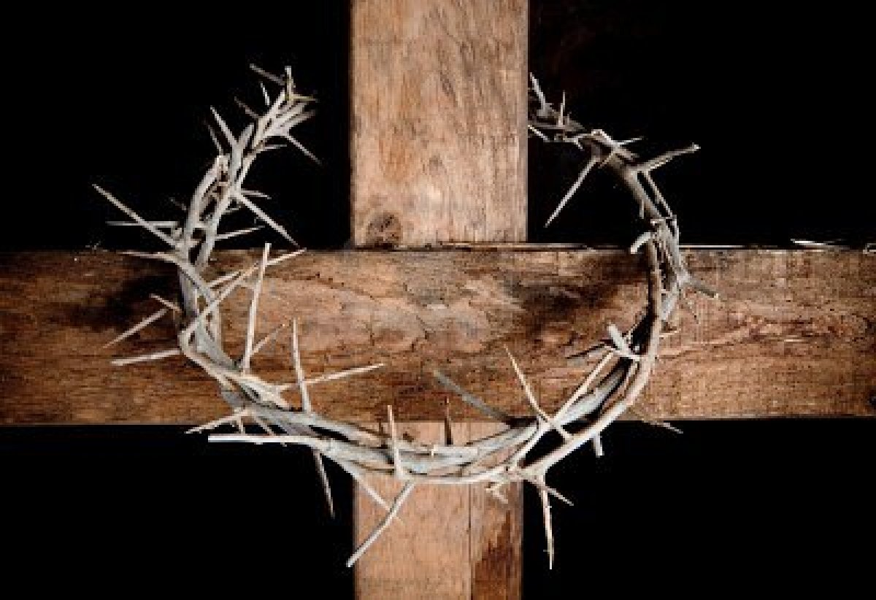
In Matthew 26:28 Yahusha Himself said that
His blood was shed “for the remission of sins.”
Not to do away with any part of the Torah!

Slide 105
John 1:7 says that His blood
“cleanses us from all sin;”
1 John 3:5 says “he was manifested to take away our sins;” and
Revelation 1:5 says He “washed us
from our sins in his own blood.”

Slide 106
There is no text, not even a hint, that says He came to do away with the Torah or any part of it. THAT would contradict with the new covenant that the Torah will be written in our hearts.
In fact, He confirms this in Matthew 5:17, saying:
“Think not that I have come to destroy
the law (Nomos = Torah), but to fulfill”
(to give them their full meaning or to make them come true).

Slide 107

John 1:1-3 tells us that He was the Word of Elohim, and He was
with YHVH from the beginning, and through Him all things
were made.
Why would He come to destroy what He made?

Slide 108

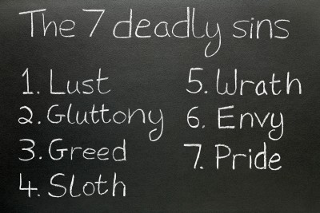
Remember, Yahusha did not come to abolish the Torah or any part of it, which is righteous and holy, but to blot out the record of transgressing
the Torah, which is our sin.

Slide 109
So what is
the issue in
Colossians 2:14 about the handwriting that
was against us?

Slide 110
It speaks here about a “certificate of indebtedness,” an “IOU” or a “note” where
our sins are registered!
The “handwriting of ordinances” is a record
of our sins (not the Torah of YHVH).
It is our indebtedness due to the transgression
of His Torah.
It is a death certificate that is nailed to the cross!
OUR “death” certificate, that is!

Slide 111
To repeat it again...
The certificate of indebtedness, the list of our committed sins, which required our death were nailed to the tree.
Col 2:14 in no way nails any Law to the tree.
In order NOT to be misunderstood:
The sacrifices and oblations ended at the stake!
That is a fact! Col 2:14 cannot be used as a proof text to do away with the weekly Sabbath nor the yearly appointed times.

Slide 112
WHY NOT?
Because Colossians 2:14 speaks about a certificate of indebtedness, an “IOU” (I owe you),
a list of our sins – not a list about
Moral and/or Ceremonial laws.

Slide 113
One can not call the yearly divine appointments a
“death certificate” or a
“certificate of indebtedness,”
that ended at Calvary.
The yearly appointed feasts point to
a “shadow of things to come
in the future.” “They are a compacted prophecy of the plan of salvation!”

Slide 114
This is brought out in Colossians 2:17!
“Which are (not were) a shadow
of things to come, but the body
is of Messiah.”
The word “are” is in the present tense and a promise of a future fulfillment, which is still ahead.

Slide 115
Why is Paul using present tense thirty (30) years after the crucifixion, IF the feasts,
New Months, the Sabbath and the
food laws were already fulfilled?
Because the Greek text is written
in the present tense!

Slide 116
What about the second half of Colossians 2:17?
“but the body is of Messiah.”
Does this sentence
make sense?
What does that mean?
What is Paul trying to say?

Slide 117
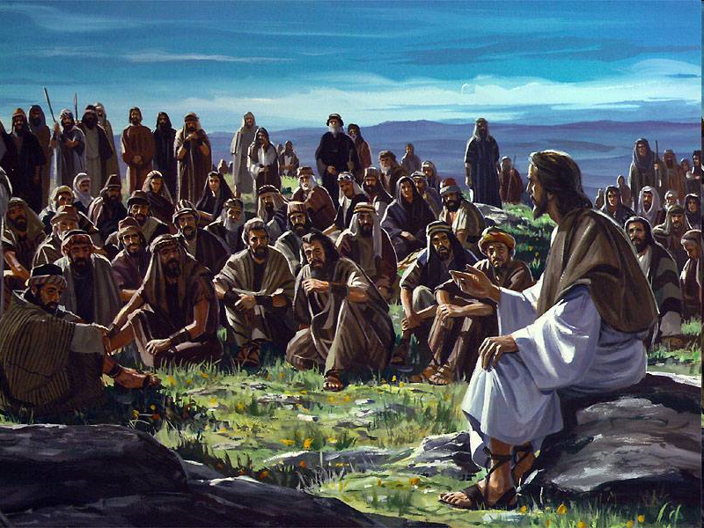
What is the body of Messiah?
“And He (Yahusha) is the head of the body, the church
(the assembly, the congregation)”
(Col 1:18)

Slide 118
“For His [Messiah] body's sake, which
is the church”
(the assembly, the congregation in Col 1:24).

Slide 119
The Body of Messiah is
His assembly of believers that follow His instructions!

Slide 120
The last part of Colossians 2:17
relates to verse 16, where it states:
“Let no man therefore judge you…
[in these matters]
but the body of Messiah [judges]
[which is the assembly].”

Slide 121
In other words, Paul is telling the Colossians that no one should be judging them on these matters
if they aren’t part of His assembly
and part of His people.

Slide 122


Slide 123
Paul (in Colossians 2) is not focusing on the Torah. But rather, he is focusing on Yahuwah’s forgiveness and the completeness in Yahusha.
Paul did NOT do away with any laws, because he says in Acts 25:8 “Neither against the law of the Jews (G3551 = Greek Nomos – Hebrew Torah),
neither against the temple,
nor yet against Caesar,
have I offended anything at all.”

Slide 124
We have been forgiven of our sins and trespasses, let no man therefore judge you but the body of Messiah,
which is the true assembly
according to the righteous standard,
which is the Word of Yahuwah.

Slide 125
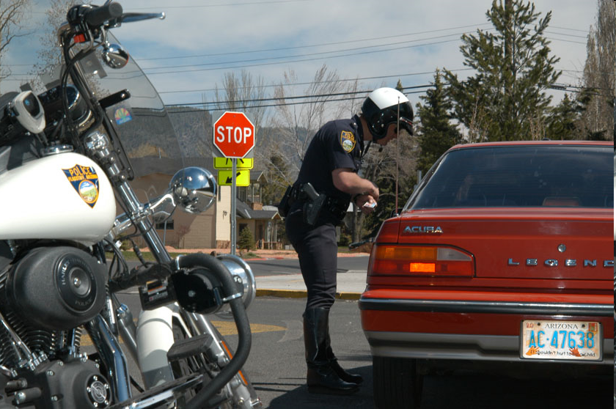
If you get a speeding ticket and someone pays your fine…does that abolish the speed limit law, or your debt for the ticket?
Only your DEBT is being abolished!

Slide 126
Only the ticket was paid for and taken care of,
but the law is still in force.
Try to speed again and you will find out,
that the law is still in force.

Slide 127
Colossians 2:15 “And having spoiled principalities and powers, he made a shew of them openly, triumphing over them in it.”
Who are those principalities and powers
that try to judge Yahuwah’s people?

Slide 128
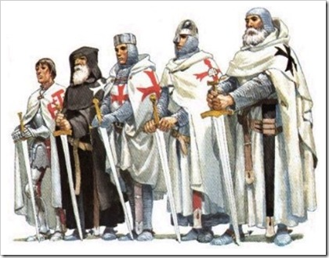
These terms refer to earthly rulers
(see Luke 12:11 & Titus 3:1) as well as to the
powers of darkness,
but Yahusha triumphed over all of them, specifically over Satan and his angels.

Slide 129
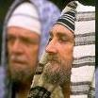
In other literature the “powers” are explained:
…to be the false Jewish leaders to destroy faith in Yahusha,
and the “principalities” were
the Roman civil magistrates
such as governors, etc.

Slide 130
At any rate, the principalities and powers are the enemies.
Therefore, the words of Paul: “Let no man, regardless of his position as a principality or power, judge you in regard
to your religious beliefs.”

Slide 131

I rest my case!

Slide 132

SHALOM
THE END

Slide 133


Supreme Provider –
Yahusha Ha Mashiach
Produced and Narrated
by Walter Tschoepe
Malachi4.4@Reagan.com

